Slide 1
Dashboard Presentation
Project: Retail Supply Chain Sales Dashboard Analysis
Name: Md. Zubayer Hasan

Slide 2
Project Goal
Focused on analyzing key performance metrics.
Identify high-performing products and customer segmentation.
Analyzing discount and pricing strategies
Recommendation above trends

Slide 3
Data collection and preprocessing
Dataset: Retail Supply Chain Sales Data
Source: Kaggle (.xlsx file)
Cleaning: Handled missing values, formatted dates.

Slide 4
Data collection and preprocessing
Cleaning
Handled missing values:
Detected null entries in the dataset.
Replaced missing profit values with the average profit.
Processed directly in Excel before visualization
Formatted Dates values:
Converted date strings to proper Date Time format.
Processed directly in Excel before visualization.

Slide 5
Analysis
Descriptive Analysis:
Revenue trends Over Time
Region-wise Total Volume Percentage
Revenue Contributions by Customer Segment
Category-wise Gross Volume
Sub-category-wise Total Quantity
Ship mode wise gross volume and profit
Diagnostic Analysis:
product profitability challenges
Percentage of Highly Returned Sub-category
Predictive Analysis:
Next 3 Years Revenue Prediction

Slide 6
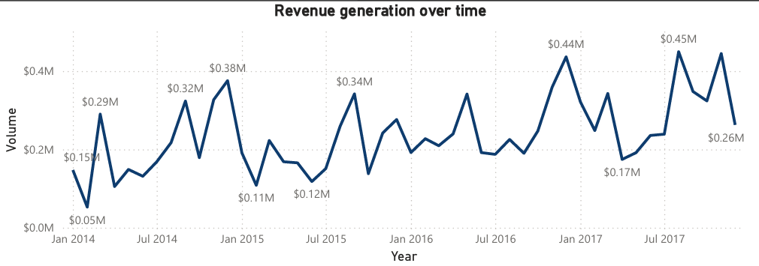
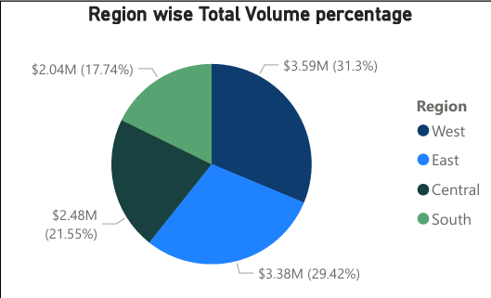
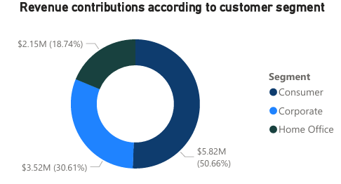
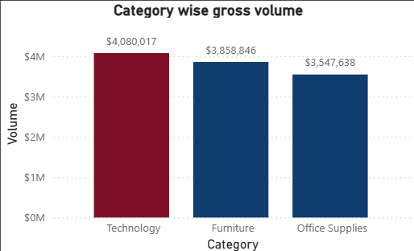
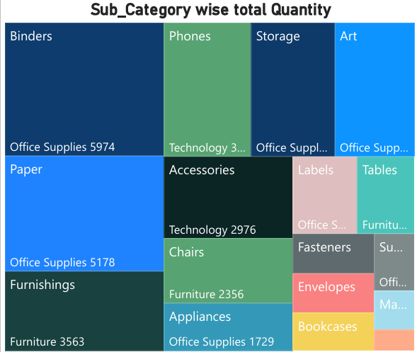
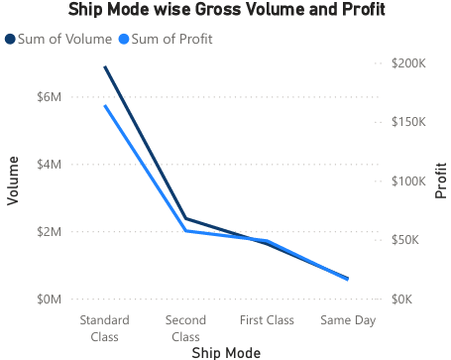
Descriptive Analysis

Slide 7
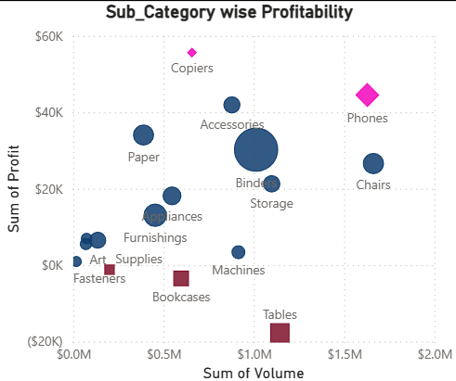
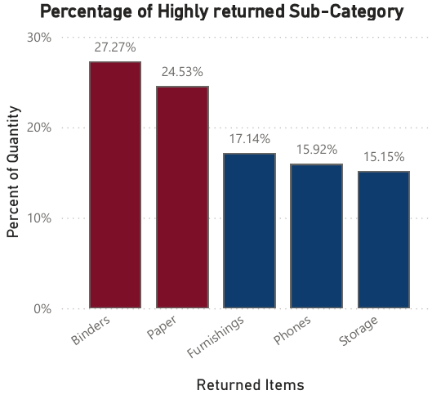
Diagnostic Analysis
Profitability challenges
Highly returned Sub-category

Slide 8
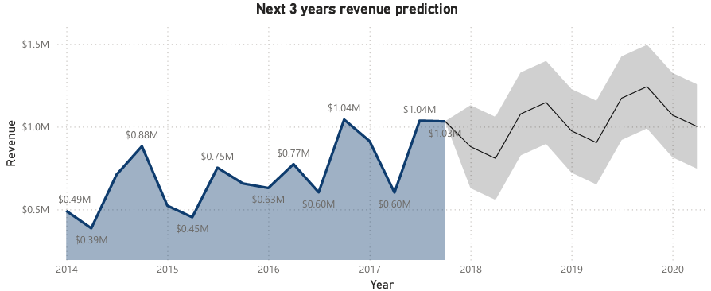
Predictive Analysis
Next 3 years revenue prediction

Slide 9





Key Performance Indicators

Slide 10
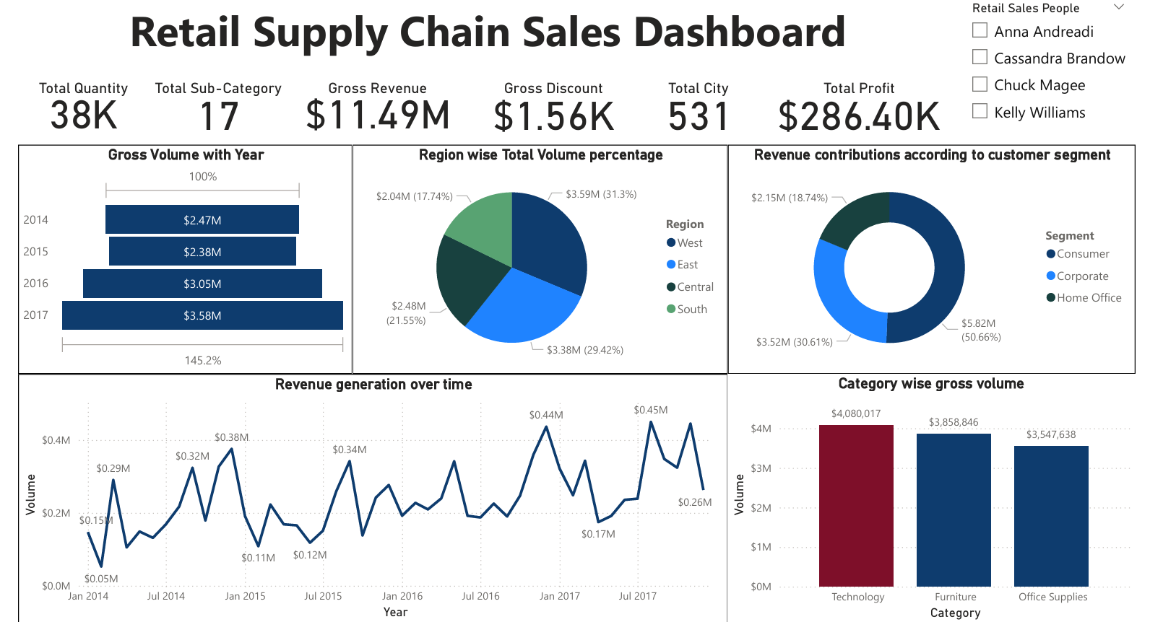

Slide 11
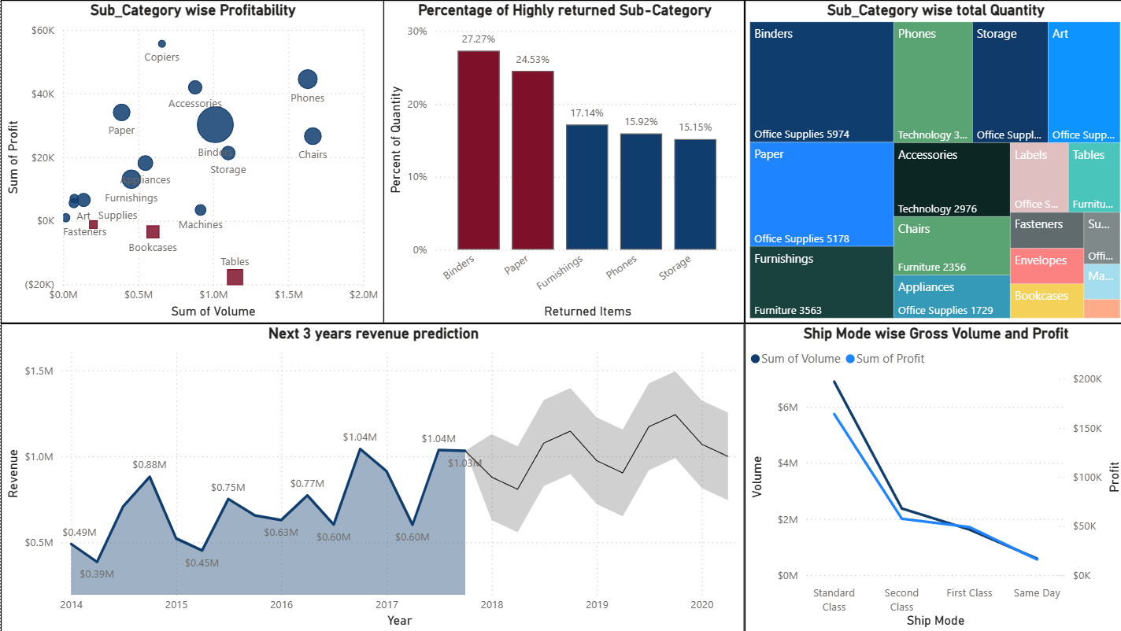

Slide 12
Key Insights and Diagnoses
Revenue Trends over time:
Sales volume consistently peaked in Quarter-4, highlighting the importance of seasonal campaigns. Quarter-1 and Quarter-2 showed potential for improvement.

Slide 13
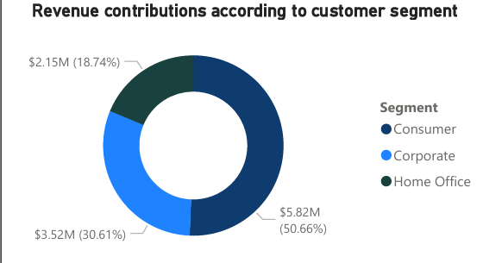
Key Insights and Diagnoses
Regional revenue analysis:
The West region contributed the most revenue 31.3%, followed by the East 29.4%.
Customer segmentation:
Among customer segments, Consumers drove $5.8M in revenue, which highlights Consumers as our most valuable segment.

Slide 14
Key Insights and Diagnoses
Top performed categories:
Our top-performing category is Technology, contributing
$4.08M to revenue.
Sub-Category wise sold Quantity:
Interestingly, Office Supplies drives the highest quantity sold 22.9K units, with sub-categories like Binders 6K and Paper 5.2K being the most popular.

Slide 15
Key Insights and Diagnoses
Profitability Analysis:
While some sub-categories, like Copiers and Phones, generated significant profits of $56K and $45K, others, such as Bookcases, Tables and Supplies, incurred losses of $18K and $1K. These are need to have a closer look at production costs and discount strategies in these underperforming areas.

Slide 16
Key Insights and Diagnoses
Returns Analysis:
Returns are an area of concern, particularly in Binders and Paper, which have return rates of 27.27% and 24.53%, respectively.

Slide 17
Key Insights and Diagnoses
Predictive Analysis:
We’re projected to reach $1.6M by 2020, reflecting steady growth.

Slide 18
Final Findings
Significant revenue spike due to seasonal demand, holiday sales, and end-of-year purchasing trends.
Highest revenue generates by Technology.
Certain sub-categories (Binders, Paper) had notably high return rates, indicating potential quality or customer satisfaction issues.
Bookcases, Tables and Supplies, incurred losses due to high discounts.

Slide 19
Recommendations
Over Time Revenue: Focus on Q4 Campaigns, allocate more marketing and inventory resources to maximize seasonal demand. Boost Q1 and Q2 sales launch targeted promotions or discounts to improve early-year performance.
Optimize Low-Profit Sub-Categories: Reassess pricing, cost, and discount strategies for Tables and Supplies.
Reduce Returns: High discounts are a likely contributing factor to the underperformance of sub categories like Tables, Supplies, and high-return items like Binders and Paper. Strategic discounting can mitigate this issue.

Slide 20
Thank You🙂

